Slide 1
Predicting Company Bankruptcies
Name – Pushpak Sanjay Shrimal
Spinnaker Analytics

Slide 2
What is Bankruptcy
Bankruptcy is a legal proceeding initiated when a person or business cannot repay outstanding debts or obligations. It offers a fresh start for people who can no longer afford to pay their bills.
The bankruptcy process begins with a petition filed by the debtor, which is most common, or on behalf of creditors, which is less common. All of the debtor's assets are measured and evaluated, and the assets may be used to repay a portion of the outstanding debt.

Slide 3

Table of Contents
Load data
- 1.1 Import the libraries
- 1.2 Load the dataset
2. Exploratory Data Analysis
- 2.1 Understanding dataset
- 2.2 Data Cleaning
3. EDA and Visualization
- 3.1 Feature Selection
- 3.2 Data Visualization
- 3.3 Imbalanced Data
- 3.4 Splitting and training
4. Model building
- 4.1 Logisitc Regression
- 4.2 KNeighborsClassifier
- 4.3 Decision Tree
- 4.4 Random Forest
- 4.5 SVM
- 4.6 ANN
5. Result
6. Conclusions

Slide 4
Importance of the Project
Improved Risk Management:
Identify companies at high risk of bankruptcy.
Enable proactive measures to mitigate financial losses.
Better Decision Making:
Support informed lending and investment strategies.
Portfolio Optimization:
Assist in maintaining a balanced and low-risk financial portfolio.

Slide 5

Problem Statement
Develop a robust machine learning model to accurately predict company bankruptcies. By utilizing this model, the institution aims to improve risk assessment, make informed lending decisions, and optimize their financial portfolio management.

Slide 6
Dataset Information
Here are the key details about the dataset used in this project:
Number of records: Our dataset comprises a robust collection of data, consisting of 6,820 records. Each record represents a unique entry, contributing to the richness and depth of our analysis.
Features/Columns: The dataset is characterized by a diverse set of features, each providing valuable insights. In total, there are 96 features/columns that form the basis of our predictive modeling.
Source of the Data: The dataset is sourced from LMS, ensuring reliability and relevance. The data's origin plays a crucial role in shaping the context and ensuring that our analysis is grounded in real-world scenarios and industry dynamics. Here are the key details about the dataset used in this project:
.

Slide 7
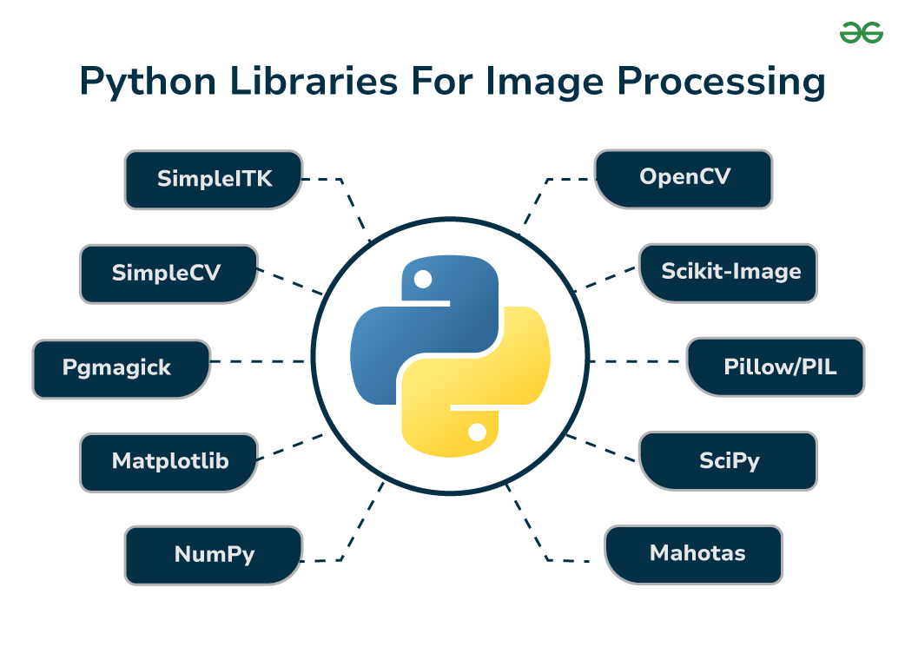
Dataset Information
# Importing 'Pandas’
import pandas as pd
# Importing 'Numpy'
import numpy as np
# Importing 'Matplotlib'
import matplotlib as plt
import matplotlib.pyplot as plt
# Importing 'Seaborn'
import seaborn as sns
# To supress warnings
import warnings
warnings.filterwarnings('ignore’)
import random

Slide 8
Libraries Imported
from sklearn.model_selection import train_test_split
from sklearn.preprocessing import LabelEncoder
from sklearn.linear_model import LinearRegression
from sklearn.tree import DecisionTreeRegressor
from sklearn.neighbors import KNeighborsRegressor
from sklearn.ensemble import RandomForestRegressor
from sklearn.svm import SVC
from sklearn.svm import SVCfrom tensorflow import keras
from sklearn.metrics import classification_report, confusion_matrix
from tensorflow.keras.models import Sequential
from tensorflow.keras.layers import Dense, Activation,Dropout
from tensorflow.keras.callbacks import EarlyStopping
from sklearn.metrics import classification_report, confusion_matrix
from sklearn.preprocessing import StandardScaler
from imblearn.over_sampling import SMOTE
from sklearn.metrics import accuracy_score, recall_score, precision_score, f1_score
from sklearn.metrics import classification_report, confusion_matrix

Slide 9
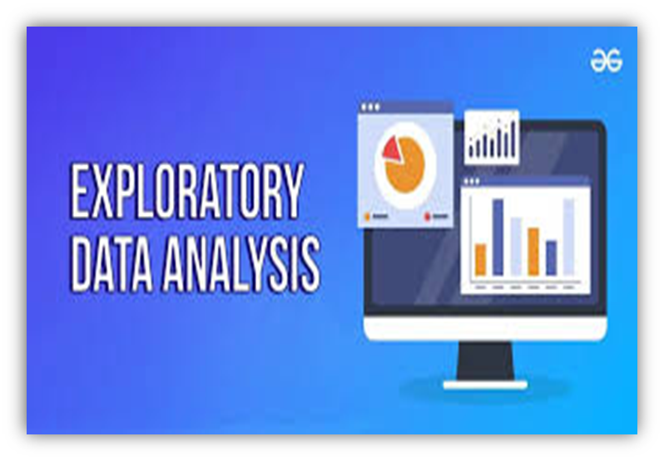
Exploratory Data Analysis (EDA)
Data exploration allowed us to gain a comprehensive grasp of the structure of the data.
It gave us vital dataset insights, helped us spot significant trends, and exposed potential patterns.
We looked at relationships and the distribution of the individual traits. and during the EDA process examined any inherent relationships between variables.

Slide 10
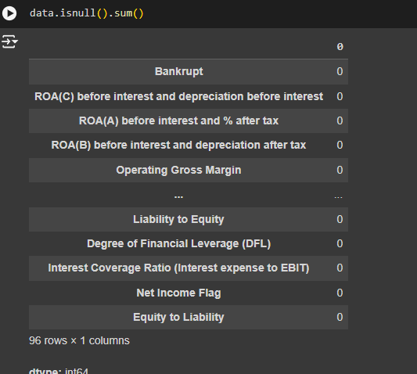

Exploratory Data Analysis (EDA)
Null Values
Finding Duplicate data

Slide 11
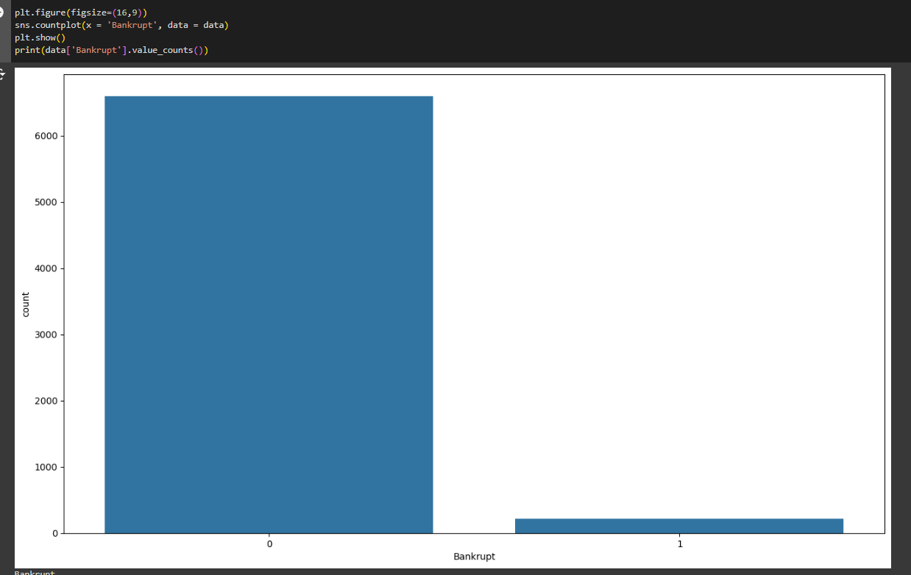
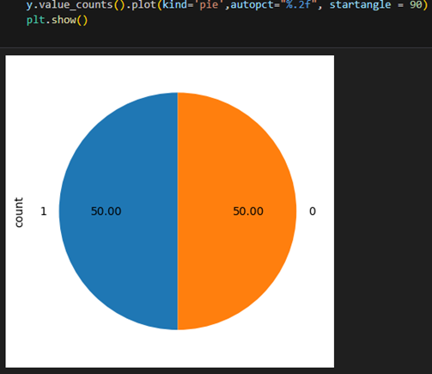
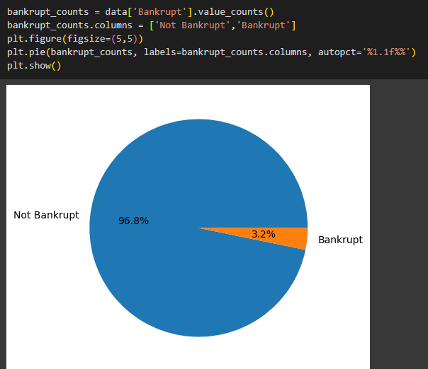
Visualizations
Image 1
Image 2
Image 3

Slide 12
Splitting the data into X and y
In this step, we partitioned the dataset into two components: X and y.
The variable X encompasses all independent variables, representing the features that contribute to our predictions.
On the other hand, y encapsulates the dependent variable or target variable, serving as the outcome we aim to predict.
Train-Test Split
Next, we divided the dataset into test and training sets.
We split our data 70:30, which means that 70% of it is training data and the remaining 30% is testing data. Thus, we used a test size of 0.2.
For Random State, we used 0. This ensured that our results would be consistent between runs.
To make sure that our Target Variable (y) is spread proportionately, we additionally used Stratify = y.

Slide 13
Machine Learning Algorithms
This Solar Energy Production challenge is one of multiclass classification.
Models used:
Linear Regression : Linear regression is a statistical technique for modeling and predicting the connection between a dependent variable and one or more independent variables by fitting a linear equation to observed data. The purpose is to determine which linear equation best describes the variance in the dependent variable as a function of the independent variables.
DecisionTreeRegressor : Decision trees use a tree structure to construct models for classification or regression. It partitions a dataset into progressively smaller subgroups and simultaneously builds a corresponding decision tree piecemeal. A tree containing decision nodes and leaf nodes is the end product.
KN-Neighbour Regressor : A machine learning technique called the KN-Neighbour Regressor is used for regression problems. It predicts a target variable's value by averaging, or weighting, the target values of the k nearest neighbors in the future space.
Random Forest Regressor : Random Forest Regressor: Designed for regression problems, a Random Forest Regressor is an ensemble learning technique that generates numerous decision trees during training and outputs the mean of them in order to reduce overfitting and increase accuracy.
SVC : Support Vector Regression (SVR) is an extension of Support Vector Machines (SVM) that can be used to solve regression problems. It optimizes a function by finding a tube that approximates a continuous-valued function while minimizing the prediction error.
ANN : A neural network is a method in artificial intelligence that teaches computers to process data in a way that is inspired by the human brain. It is a type of machine learning process, called deep learning

Slide 14
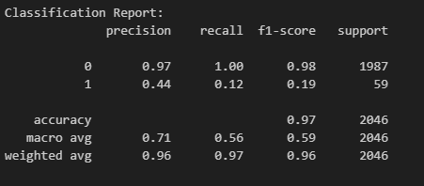
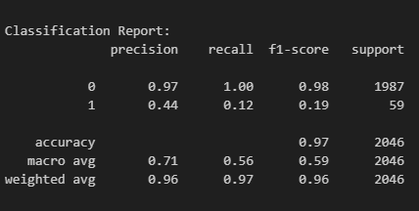
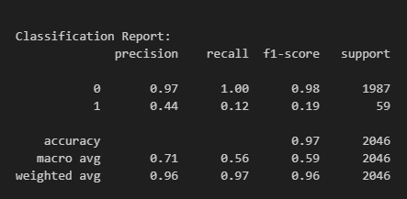
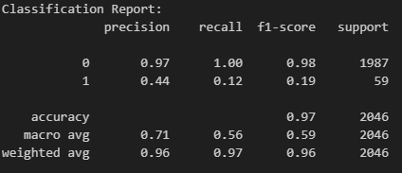
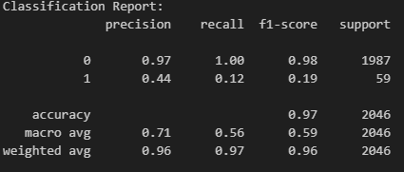
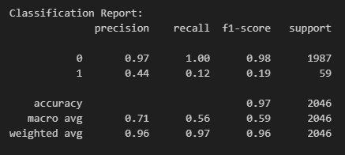
Results
DecisionTreeRegressor
Linear Regression
KN-Neighbour Regressor
RandomForestClassifier
SVC
ANN

Slide 15
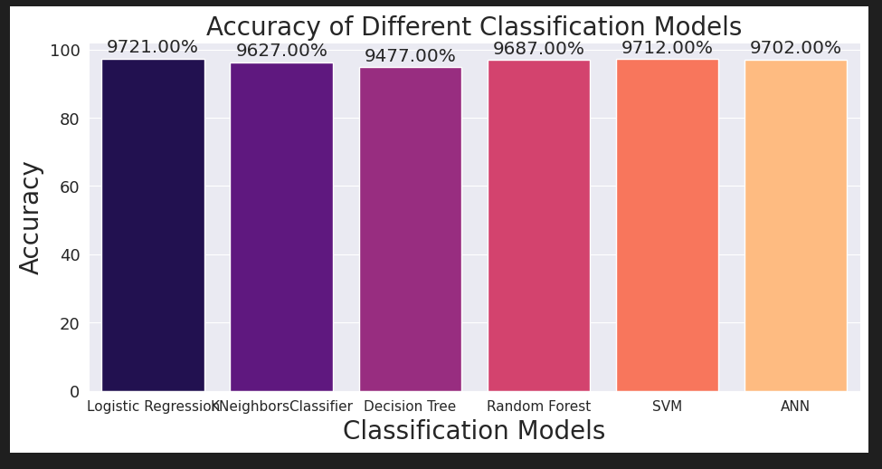
RESULTS

Slide 16
Conclusion
Corporate default forecasts are utilized in a variety of economic areas. Corporations can use prediction models to assess their existing situation and develop strategy. Executives may improve their organizations' stability by monitoring key parameters that determine a company's default risk. Investors can enhance their portfolios and strategies by assessing the company's chance of default. Governments can also use corporate default projections to develop macroprudential policies and strengthen relevant financial laws. In these ways, default prediction models aid in the design and improvement of financial systems. Corporate default projections, which use machine learning algorithms and statistical models, are also at the forefront of modern financial engineering. The current global financial crisis, as well as a rise in credit risk, have underlined the sector's importance.
Because of their importance, corporate default predictions have been widely studied.In this analysis, some important results were found as follows:
The topic uses Machine Learning models to come up with the best model for predicting bankruptcy at companies.
The best model given is the Logistic Regression Model.
The accuracy of the built model is 97.21%. ROC is very high (auc = 92.6%).
In addition, the top 10 features that have a major impact on Bankruptcy include:
Continuous interest rate (after tax),
Persistent EPS in the Last Four Seasons
Per Share Net profit before tax (Yuan ¥)

Slide 17
Conclusion
Debt ratio %
Net worth/Assets
Borrowing dependence
Net profit before tax/Paid-in capital
Net Income to Total Assets
Net Income to Stockholder's Equity
Equity to Liability
In short, building a model to predict default risk (or bankruptcy risk) is very important for every business. Therefore, when undertaking corporate default forecasting, it is necessary to choose an appropriate method that can provide appropriate information for forecasting purposes, which requires a thorough understanding of the appropriate use of each method.
In the future, it is possible to combine other Machine Learning models such as Gradient Boosted Tree, , GBM to create a model with higher accuracy.

Slide 18
Q&A
Questions ?
1.
2.
3.
4.
5.
6.

Slide 19
THANK YOU

